Slide 1
Travelling Salesman Problem
An NP-hard optimization problem
A number of heuristics and metaheuristics
Of practical importance ( == permutation problem)
Rich repository of test problems (e.g. TSPLIB)
http://elib.zib.de/pub/mp-testdata/tsp/tsplib/tsplib.html

Slide 2
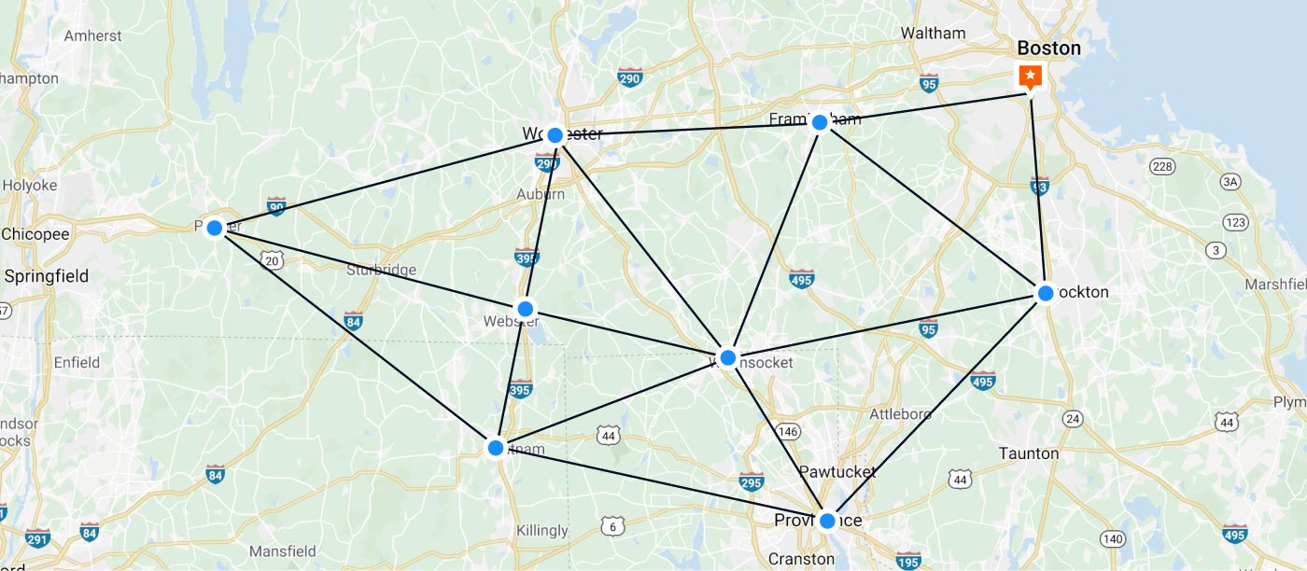
Travelling Salesman Problem

Slide 3
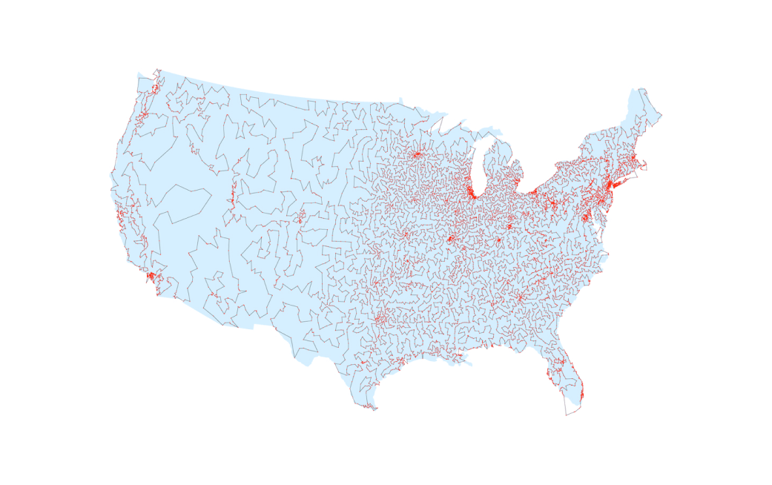
Travelling Salesman Problem

Slide 4
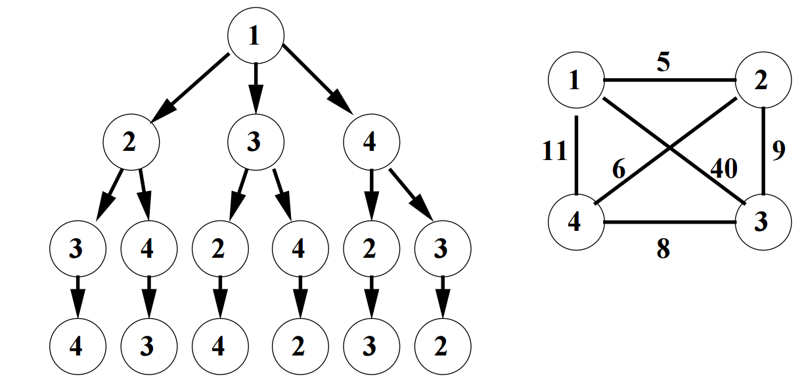
Solving TSP
Brute-force
Branch-and-bound

Slide 5
Today
Brute-force (with threads)
Branch-and-bound (with threads)

Slide 6
Today
Brute-force (with threads)
Branch-and-bound (with threads)

Slide 7
Assignment
Download a TSPLIB instance
Create a program to solve TSPLIB by the branch-and-bound method
Efficiently parallelize the program
e. g. using threads

